Slide 1
Fabric Presence & Wrinkle Detection using Capacitive Sensing
Dhaval Kalathiya
+49 (0) 15566043387
kalathiyadhaval1512@gmail.com
LinkedIn

Slide 2
Fabric Presence & Wrinkle Detection using Capacitive Sensing
This project focuses on designing a capacitive sensing circuit to detect fabric properties, including fabric presence and wrinkles, for robotic applications. The system is designed to integrate with robotic arms or textile automation systems to identify fabric positioning, texture, and surface irregularities.
The core challenge was to select the best sensor technology for non-contact fabric detection, ensuring high precision, low power consumption, and minimal interference from environmental factors.

Slide 3
Fabric Presence & Wrinkle Detection using Capacitive Sensing
I have divided this project different sections.
Sensor selection
Flowchart
Schematic Design
PCB Design
Coding
Mock data simulation

Slide 4
Equipment Selection
Custom designed copper capacitive plate
MPR121 (Proximity capacitive sensor controller)
Arduino Nano
OLED Display
Resistors
Capacitors

Slide 5
Sensor Selection - Capacitive
Why capacitive sensor ?
Non-contact measurement: Capacitive sensors can detect fabric properties without physical contact, reducing wear on both the sensor and the fabric.
Sensitivity to dielectric materials: Fabrics are dielectric materials, and capacitive sensors are particularly good at detecting changes in dielectric properties. This makes them ideal for differentiating between fabric types or detecting thickness variations.
Wrinkle detection capability: Capacitive sensors can detect distance changes at high resolution, making them suitable for detecting surface irregularities like wrinkles. When fabric wrinkles, the distance between the sensor and parts of the fabric changes, creating measurable capacitance variations.
Moisture sensitivity: They can detect moisture content in fabrics, which might be an additional useful data point for your robotics application.

Slide 6
Sensor Selection - Capacitive
Interference resistance: Compared to optical sensors like IR, capacitive sensors are less affected by ambient light conditions or fabric colour/reflectivity.
Low power consumption: Capacitive sensors typically require less power than ultrasonic alternatives, which is beneficial for battery-powered robotic applications.
Compact size: They can be implemented in a small form factor, making them easier to integrate into robotic end effectors or sensing arrays. Cost-effectiveness:
Capacitive sensing circuitry is relatively simple and inexpensive compared to some alternatives.

Slide 7
Sensor Selection
Why not ultrasonic sensor?
Resolution limitations: They typically have lower spatial resolution compared to capacitive sensors, making it difficult to detect fine details like small wrinkles in fabric.
Material penetration: Ultrasonic waves can sometimes penetrate thin fabrics, giving inconsistent readings about surface properties.
Acoustic interference: They're susceptible to acoustic noise in industrial environments.
Minimum distance requirements: Most ultrasonic sensors have a minimum detection distance (often 2-3cm), making them less suitable for very close measurements.
Angular sensitivity: They have a wider detection cone, reducing precision for small fabric features.

Slide 8
Sensor Selection
Why not IR sensor?
Colour and reflectivity dependence: IR sensors are highly affected by the color and reflectivity of fabrics. Dark fabrics absorb IR light while light fabrics reflect it, leading to inconsistent readings across different fabric types.
Ambient light sensitivity: They can be affected by environmental lighting conditions, especially if there are other IR sources nearby.
Surface angle issues: IR sensors struggle with angled surfaces, which is problematic when detecting wrinkles.
Limited material property detection: While good at detecting presence/absence, IR sensors provide less information about material properties like thickness compared to capacitive sensors.
Temperature sensitivity: IR sensors can be affected by the temperature of the environment or the fabric itself.

Slide 9
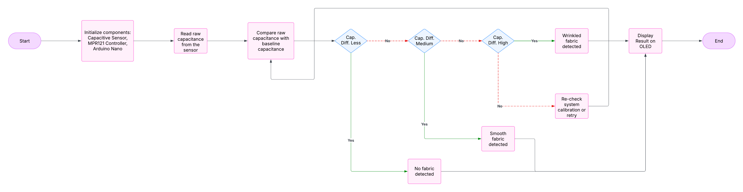
Flowchart

Slide 10
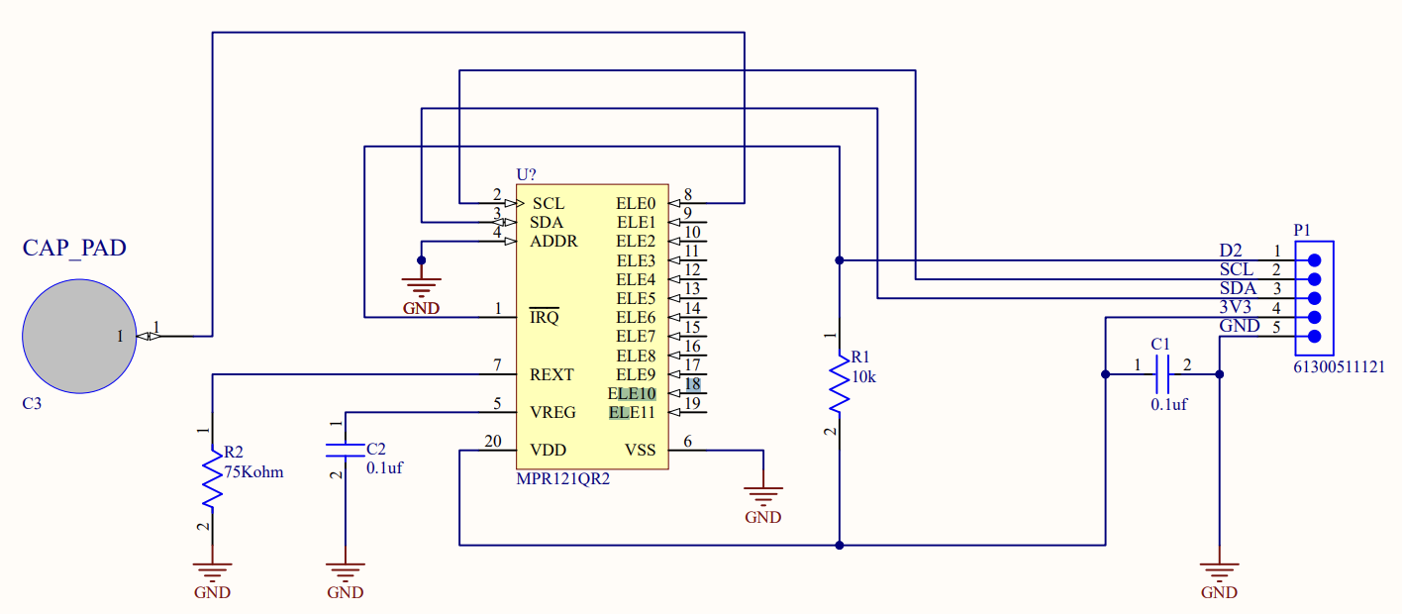
Schematic Design - Part 1
Sensor and Data Processing Side

Slide 11
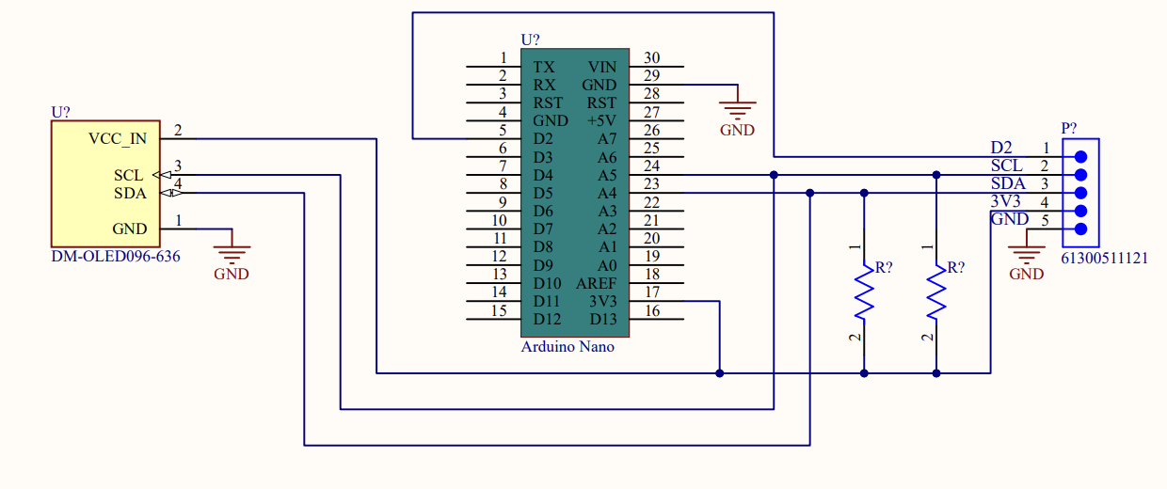
Schematic Design - Part 2
Microcontroller and Display Side

Slide 12
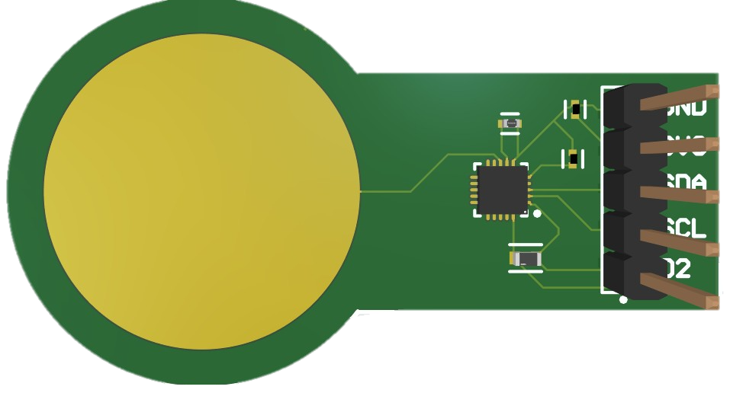
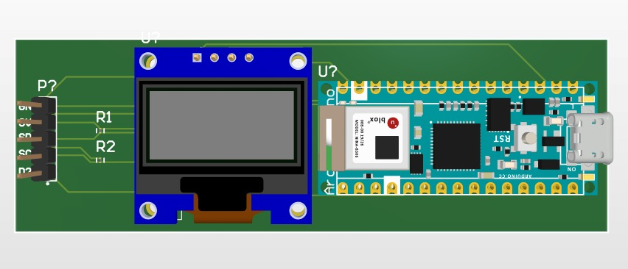
PCB Design
Capacitor Plate With MPR121
Arduino Nano With OLED Display

Slide 13
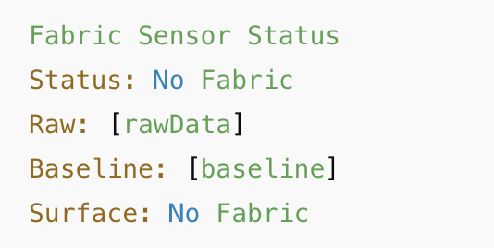
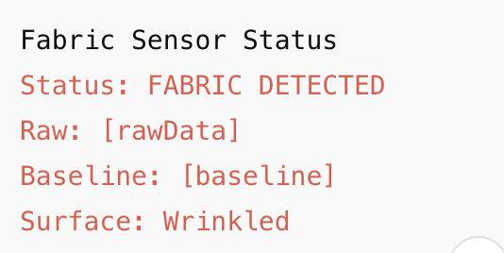
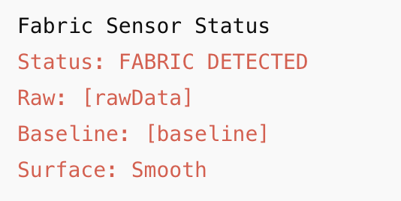
Functional Microcontroller Script
Herewith, I am showing the different outputs based on the script.
Case 1. No fabric detected Case 3. Fabric detected – Wrinkled
Case 2. Fabric detected – smooth surface

Slide 14
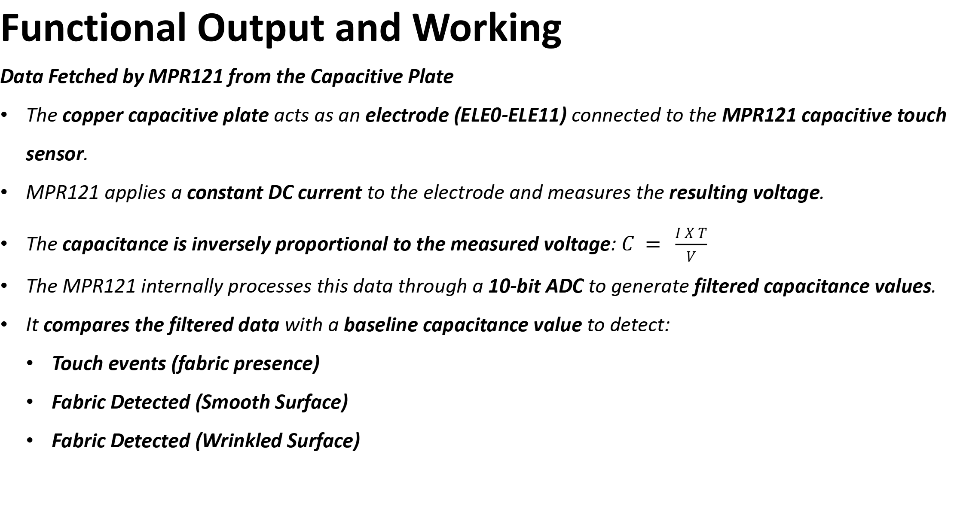
Functional Output and Working
Data Fetched by MPR121 from the Capacitive Plate
The copper capacitive plate acts as an electrode (ELE0-ELE11) connected to the MPR121 capacitive touch sensor.
MPR121 applies a constant DC current to the electrode and measures the resulting voltage.
The capacitance is inversely proportional to the measured voltage: $C = \frac{I X T}{V}$
The MPR121 internally processes this data through a 10-bit ADC to generate filtered capacitance values.
It compares the filtered data with a baseline capacitance value to detect:
Touch events (fabric presence)
Fabric Detected (Smooth Surface)
Fabric Detected (Wrinkled Surface)

Slide 15
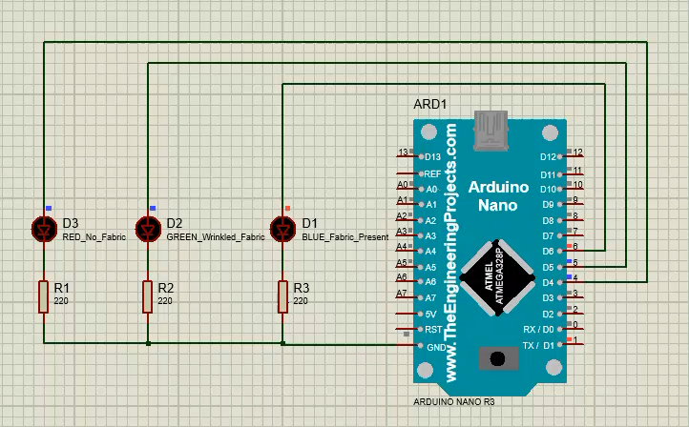
Mock Data Simulation - Proteus
Microcontroller and Display Side

Slide 16
Mock Data Simulation - Proteus
In the above slide I have simulated the circuit using arduino nano and LEDs using proteus
Where, the raw data is continuously compared (Program code and hex file attached) with the baseline data and the LEDs shows the indication of the result.
RED LED – No fabric detected
GREEN LED – Wrinkled fabric
BLUE LED – Fabric present

Slide 17
THANK YOU

